Slide 1
The Spirit of Christmas
You make a living by what you get. You make a life by what you give.
Winston Churchill

Slide 2
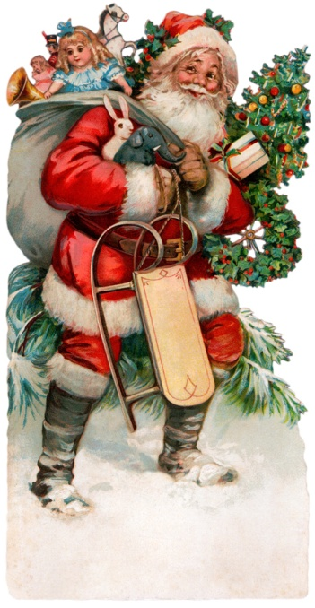
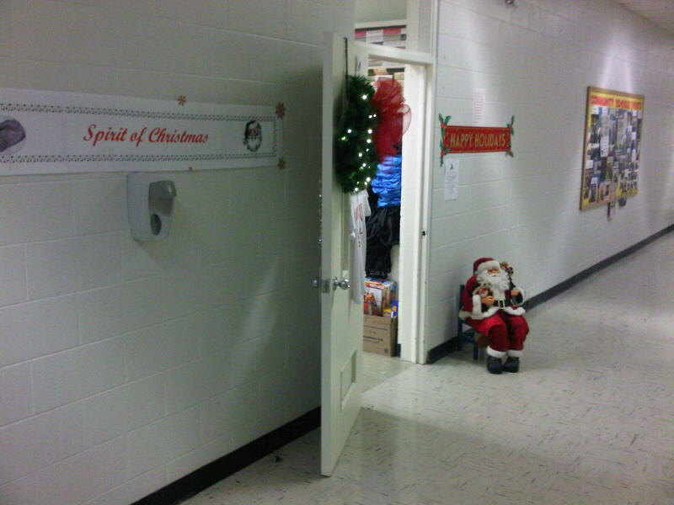

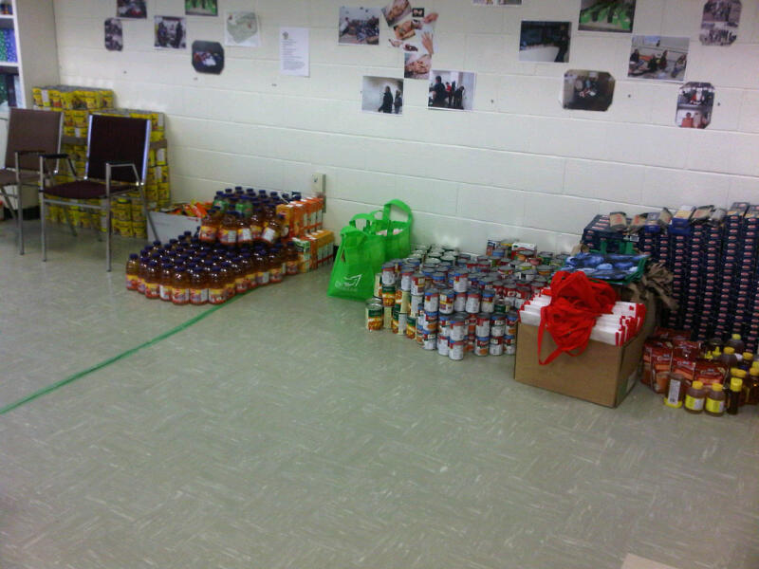
A peek into Santa’s Workshop!

Slide 3
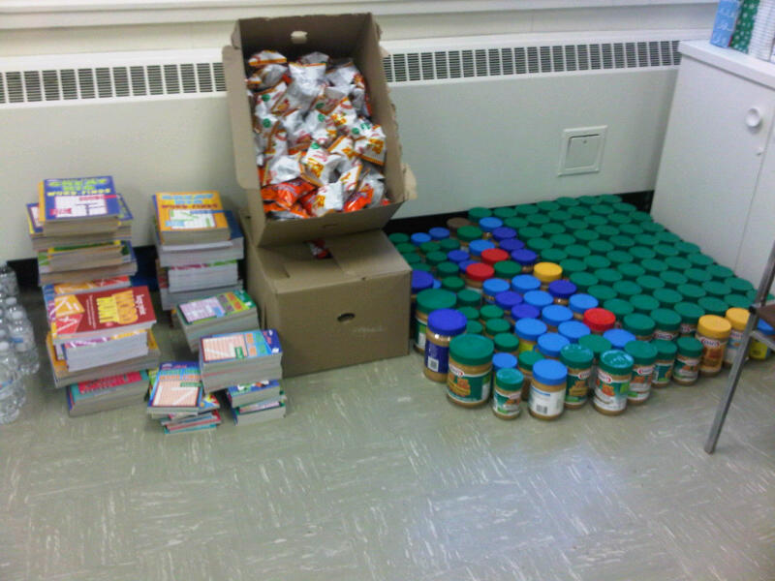


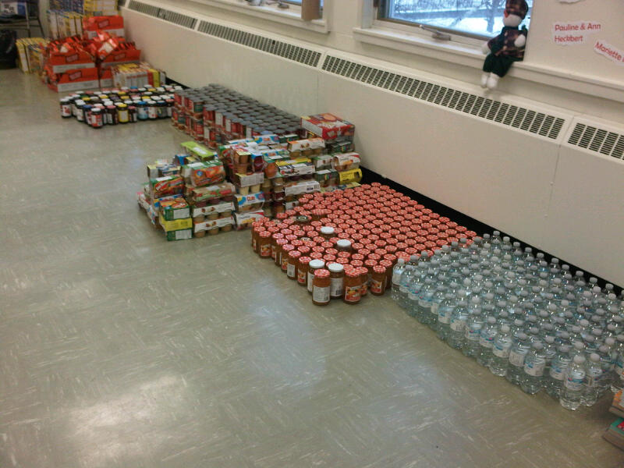
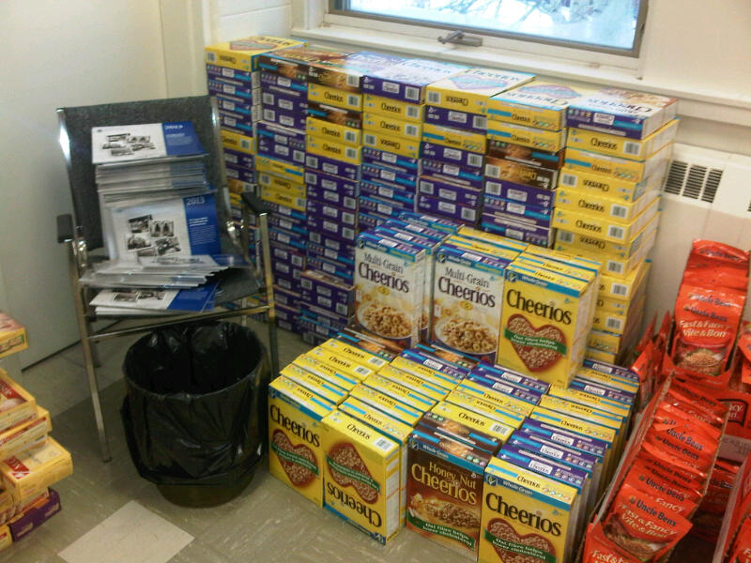

Slide 4
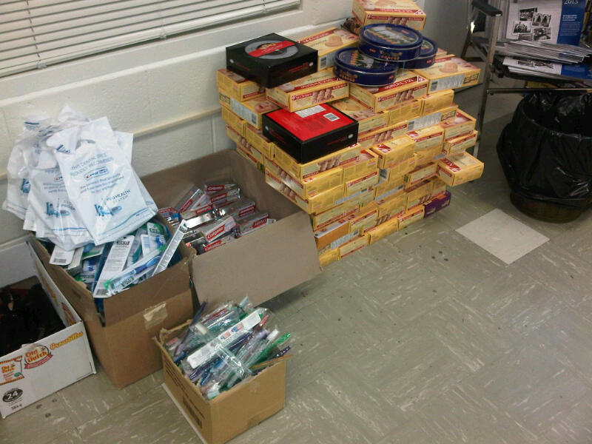
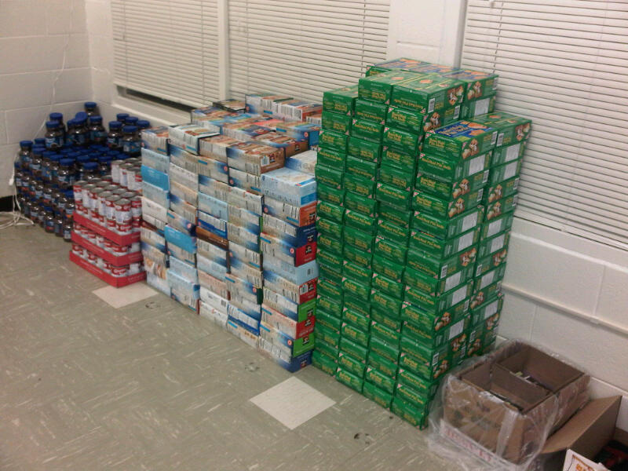
Together we can change the world, one good deed at a time.
Terry Fox Elementary collected over 140 boxes of instant oatmeal! THANK YOU!!!!

Slide 5
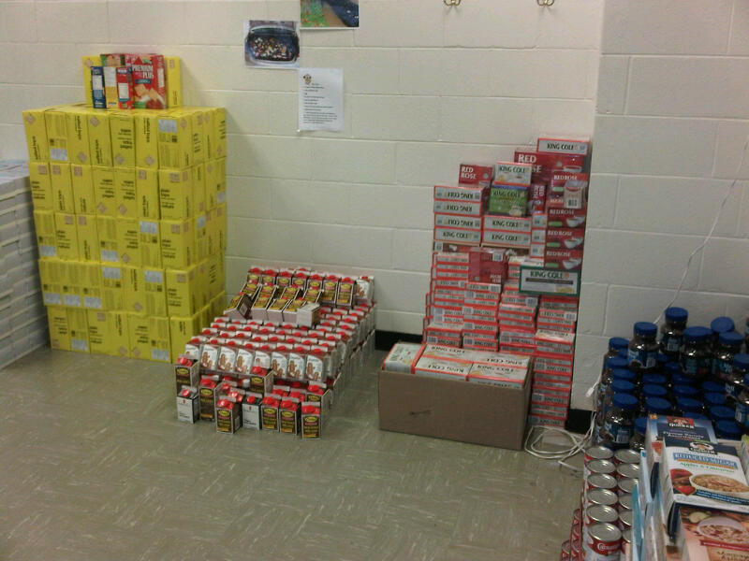
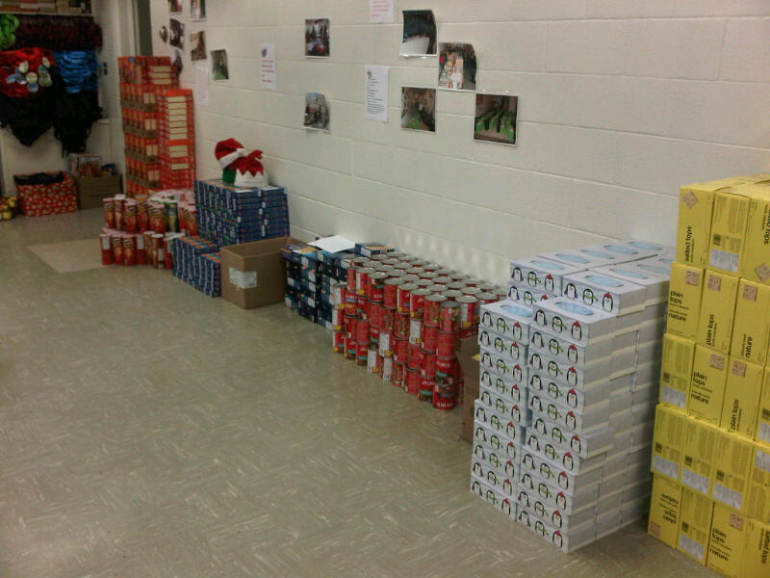

Slide 6

One piece of log creates a small fire, adequate to warm you up. Add just a few more pieces to the blast and you have an immense bonfire, large enough to warm up your entire circle of friends; needless to say that individuality counts but teamwork dynamites!
Jim Kwan
Thank you to the students and staffs of Anglophone North School District Bathurst area schools for your wonderful generosity.

