Slide 1
Pokemons
By
Matthew and Caleb

Slide 2
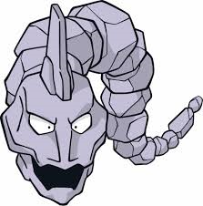
Onix
Type: Rock
Weight: 463 pounds
Ability: Rock head, sturdy
Item: none

Slide 3
Drowzee
Type: Psychic
Weight: Seventy one Pounds
Ability: insomnia
Items: none

Slide 4
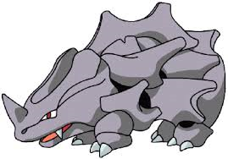
Rhyhorn
Type: rock
Weight:253 POUNDS
Ability: Lightening
ITEMS: NONE

Slide 5
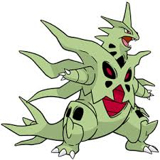
Tryanitar
Type: rock
Weight 11049
Ability: rock head
Items none

Slide 6
Gyrados
Type: water
Weight: 518
Ability: intimidate
Items: none

Slide 7
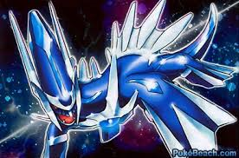
Dialga
Type: fire
Weight:200
Ability: shark
Items: none

