Slide 1
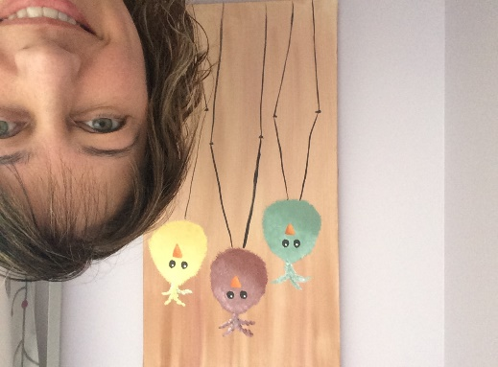
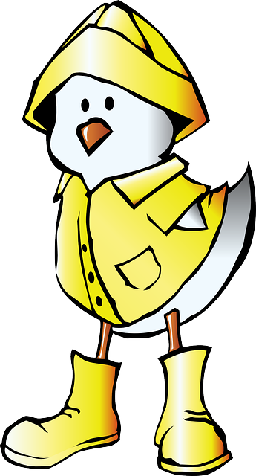
Terry Fox Elementary
Mme LeBreton’s Classroom Home learning (April 13-17)
Lecture
Mots de la
semaine
You need to continue your reading. Pretty hard if you don’t have books at home!
But if you have the Internet, I found a beauty of a site with over 10 story books. If you do one per day, we are good for two weeks. Also, on this site, you can find some word games. The name is:
Abracadabra
We are going to continue our routine of the weekly 6 words. Practice them just like you were doing during Le 5.
(#115-120)
-mon -monde
-mot -neuf
-musique -nez
Art
-This week is not Pâques! So what could we do? We are talking about birds for science, so why not birds! Look at my picture for an example of a craft.
Have fun!

Slide 2
Science
We have in grade 4 the habitats. We usually do this at the end of the school year. But with the sun coming out and the birds flying around, I found a nice project that I couldn’t wait to show you!
By using an empty 2 liter pop bottle and some paint, you can make a nice bird house for them (or feeder). I left you a picture to look at.
So cute!
Math News
-This week homework will be about flashcards! Yes, I want you to make yourself some flashcards and practice the time table from 0 to 6.
You don’t want to make them? You have an Ipad?
Well, you can find a free flashcard App called: Math Flash Cards !!*
At the end of the week, make yourself a quiz of 12 equation to answer in 1 minute 15 seconds.
Practice well.
More? Go on the Internet and look for multiplication games.
Keep listening!
I would like to see you choose a French tv show (it can be a cartoon if you want) and get into the habit of listening to it every week. When the show is done, you can:
go tell someone what it was about or
write about it in a journal.
Enjoy!
Bonne semaine!

Slide 3
