Slide 1
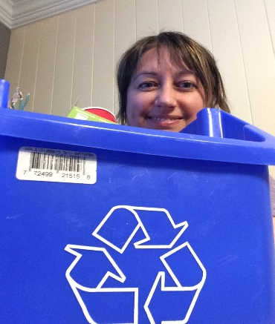
Terry Fox Elementary
Mme LeBreton’s Classroom Home learning (April 20-24)
Lecture
Mots de la
semaine
Keep reading one book per day with the site:
Abracadabra
(#121-126)
-nom -notre
-non -nous
-nos -nouveau
I found a new fun way to play with your words, yes! Go find on the Internet: Magimot (from alloprof). Type in the 6 words plus four more of your choice and play the game.
Verbes
I want you to know really well the verb être in the present tense. You can make a song or go on You Tube and listen to: verbe être au présent de l’indicatif-alain le lait.
Je suis Nous sommes
Tu es Vous êtes
Il/elle est Ils/elles sont
Art
April 22 is Earth Day! On the Internet site of DLTK, you can find some art and upcycling craft ideas under the option of: earth day.
Amuse-toi!

Slide 2
Sc. Humaine
We are going to start a new section! Exploring the world.
1)Do 3 drawings about: When I look through the window of my bedroom, an airplane, a space shuttle, I see…
2) Do a mental map of a place of your choice (ex. from home to school). Do simple shapes and a legend for a person to understand.
Look at pictures of the sheets that you would’ve received in class.
Math
-This week homework will be about flashcards. Yes, again! But this week is the time table from 6 to 9. You can also practice by making your own multiplication squares game that we had in the class. No dice? Free App for dice is: Dice Roller-Polyhedral Dice.
At the end of the week, make yourself a quiz of 12 equation to answer in 1 minute 15 seconds.
Pratique bien!
More? Go on the Internet and look for more multiplication games or do some small division.
p.s. next week, we’ll start the unit on fractions.
Écoute!
Don’t stop listening to a French tv show. And remember to talk or write about it.
Enjoy!
You can’t find something you like? Go check this place with lots of kids French shows for free!
zonevideo.telequebec.tv
Bonne semaine!

Slide 3
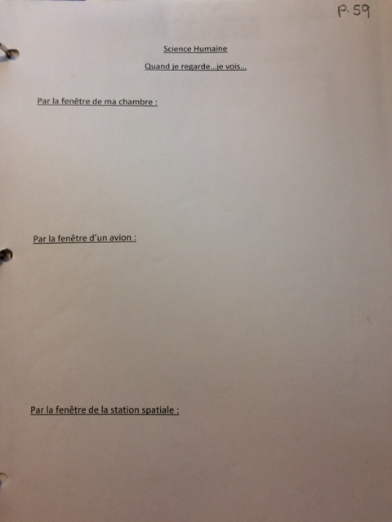

Slide 4
