Slide 1
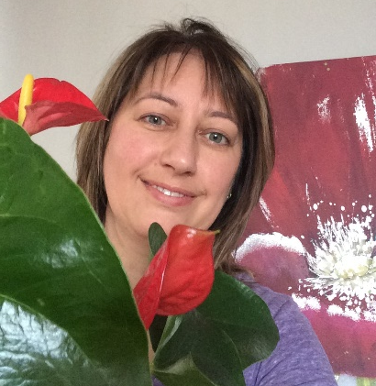
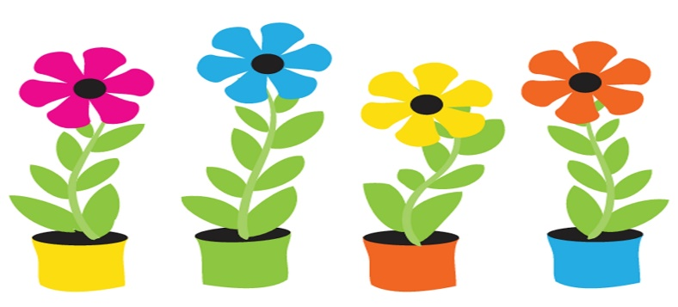
Terry Fox Elementary
Mme LeBreton’s Classroom Home learning (April 27-1)
Lecture
Mots de la
semaine
Keep reading one book per day with this new site called Bibliothèque scolaire at: educharlevoix.ca
Under Livres numériques, you can choose from 4 levels. We’ll use this site for at least two weeks.
(#127-132)
-nouvelle -onze
-nuit -orange
-oiseau -ou (or)
I’m leaving you a garden of flowers to practice them.
Verbes
I want you to know really well the verb avoir in the present tense. You can make a song or go on You Tube and listen to: verbe avoir au présent de l’indicatif-alain le lait.
J’ai Nous avons
Tu as Vous avez
Il/elle a Ils/elles ont
Art
May first is May Day and it’s all about flowers! I’m leaving you a Van Gogh Sunflowers dice art.
Amuse-toi!

Slide 2
Sc. Humaine
We are still exploring our world. This week, I want you to start knowing the continents and oceans.
You can find some really fun songs about it on You Tube, go check. My favorite is: Tour the world-official music video. J’adore! I’m also leaving some pictures to help you learn.
Math
This week homework will be about fractions.
I want you to go check on You Tube for: fractions song for kids by Numberock. The song will explain to you what is a fraction. Also a picture from the math book of the découvre section. After, you will practice doing fractions with some exercises and I found two App that you can play with.
-Fraction Lite (check the understanding section).
-Fraction Practice for kids.
You can also use fractions in the kitchen by following a recipe.
Pratique bien!
Écoute!
Don’t stop listening to a French tv show. And remember to talk or write about it.
Enjoy!
App.
amusant
et gratuit:
Duolingo Kids
Bonne semaine!

Slide 3
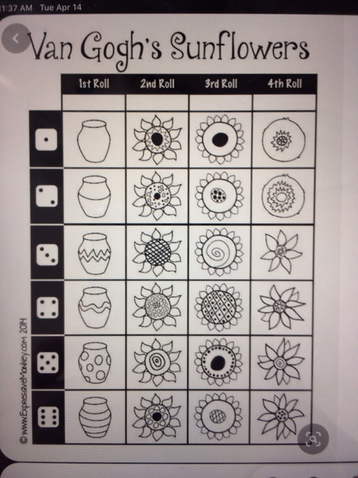
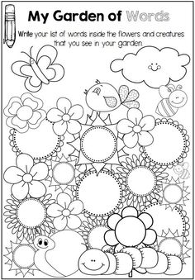

Slide 4
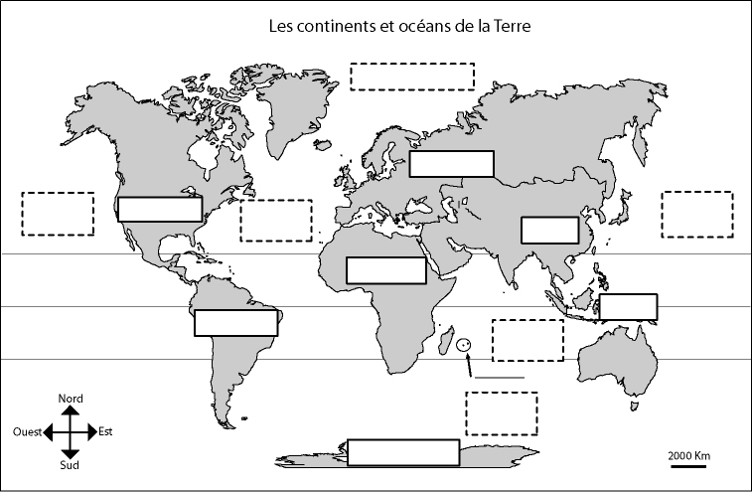
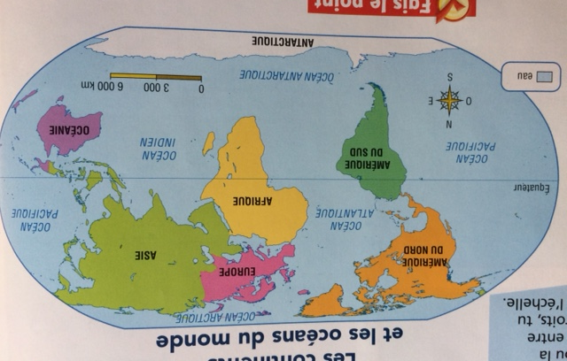

Slide 5
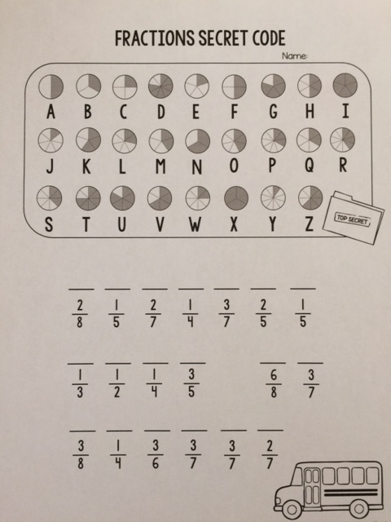

Slide 6
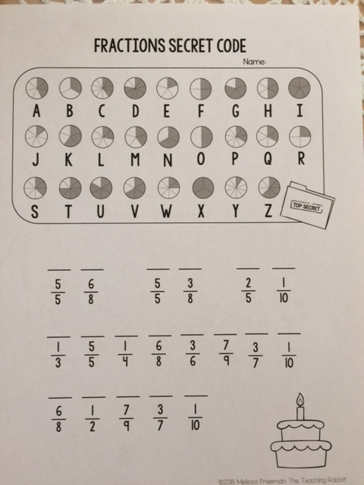
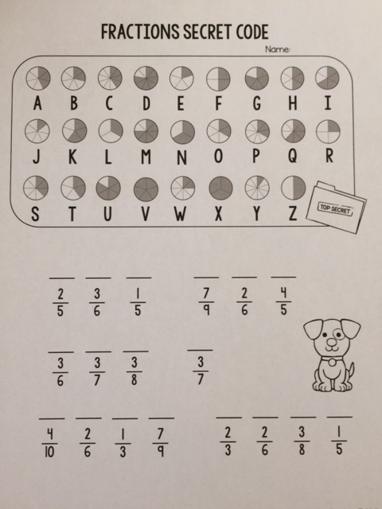

Slide 7
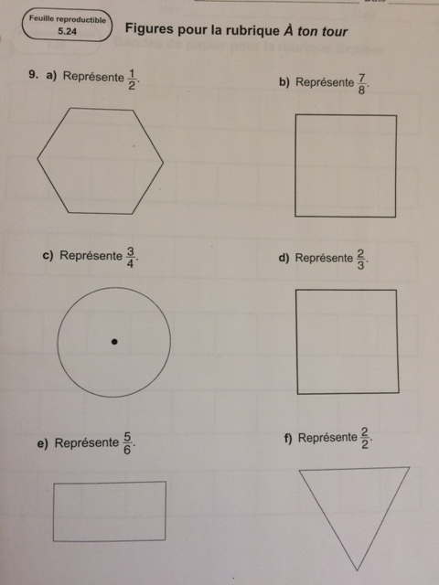
Make sure that your pieces are equal in size.

