Slide 1
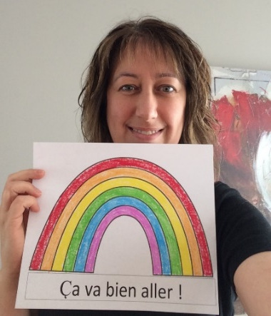
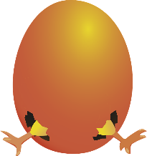
Terry Fox Elementary
Mme LeBreton’s Classroom Home learning (April 6-10)
Fur the love
of animals
Info
This is our first home learning newsletter. I hope you will like it. We are going to start with a few things and progress over time. I know this will not replace being in the class but these at home activities offer resources to continue some learning.
Miss you!
Fur the love of animals is a classroom project that we organized to help our local SPCA. Trooper the cat came to see us, so nice! I will be sending our picture this week to our local newspaper The Northern Light. Keep an eye for it!
Also, we tried to participate in a contest called: Music for Critters. But it was cancelled! They were nice enough to send us a link with songs and message. Go check.
https://www.dropbox.com/sh/fnd7fzw259lbj20/AABPNVA-uNFWRfZKCDynA8gWa?dl=0
Art
-This weekend is Pâques!
Make a craft about Easter to place on your window. You don’t have ideas? Go on the Internet and look for: DLTK crafts for kids. They have a section just for Easter.
Have fun!

Slide 2
Extra
Gym: Mme. Knowles is making a list of activities on her teacher page.
Guidance: Mme. Tracy is making a list of useful information on her teacher page.
Music: Mme. Chapman has music ideas for you on her teacher page.
Math News
-This week homework will be about graph! Our last math class was about making some diagrammes à bandes and pictogrammes. You can do one of each with things around the house. You can count: windows, doors, chairs, light bulbs…
You want to do more? You can go on the Internet and search for: graph math games. Many free games will be available for you.
Listen and talk
I would like to see you choose a French tv show (it can be a cartoon if you want) and get into the habit of listening to it every week. When the show is done, you can:
go tell someone what it was about or
write about it in a journal.
Enjoy!

Slide 3
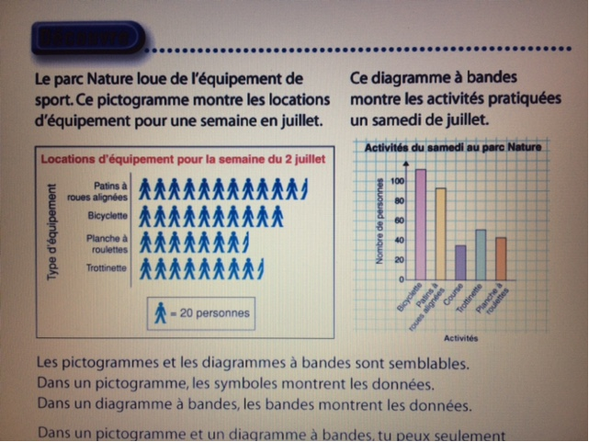
Un pictogramme Un diagramme à bandes

