Slide 1
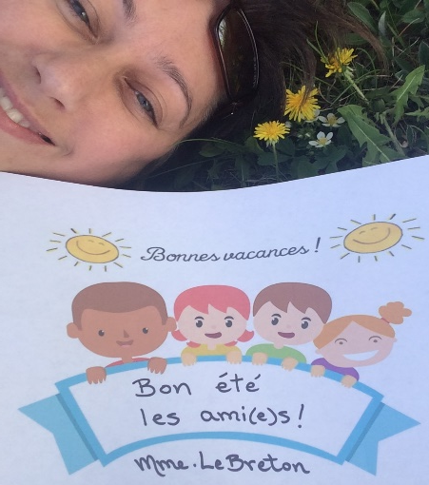
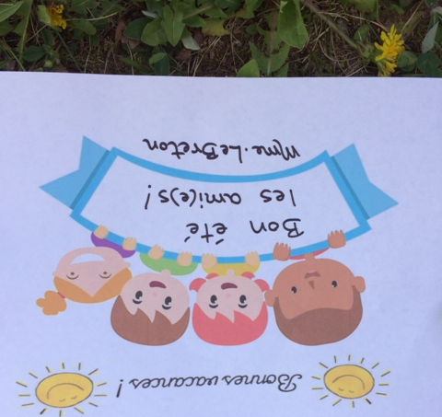


Terry Fox Elementary
Mme LeBreton’s Classroom Home learning (June 8-12)
Lecture
Mots de la
semaine
Keep reading one book per day this summer. You can continue using all the Internet sites from the home learning or go get books at the library. Remember, re-reading a good fit book is still reading.
Bonne lecture!
(#163-168)
-ses -soir
-si -sommes
-soeur -son
Regarde l’exemple pour les pratiquer.
Art
Since we are talking about habitats in science, we are going to do a diorama with the results of your science research. You can use an empty cereal box. For the inside, you can use material from the house or from nature.
Look at the example.
Amuse-toi!
Écriture
This week, I want you to write about your ideal summer! I’m leaving you a sheet to fill. Don’t answer with one word, but with a full sentence, of course.
Bonne écriture!
I had fun doing these newsletters for you. Hope you enjoyed them.

Slide 2
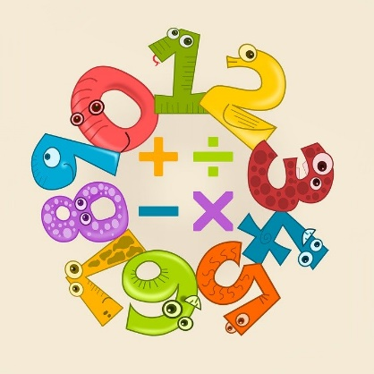


Science
We are still exploring the habitats. This week, I want you to choose an animal or insect of your choice. Go do a research on that animal\insect. Find where and how he lives. What does he need around him to survive. Then, you are going to show what you found with the art activity.
Bonne recherche!
Math
This last week of homework will be about big multiplication. I’m leaving you an explanation on how to do it and some exercises for you to practice.
Also, I found a nice way to do more multiplication. Go check free multiplication math games on the site: multiplication.com.
Pratique bien!
Écoute!
Don’t stop listening to some French tv shows this summer. There are some goods one out there, you just need to look.
Enjoy!
App.
amusant
et gratuit:
Écrire avec des syllabes
Bon été et on se voit en septembre!

Slide 3
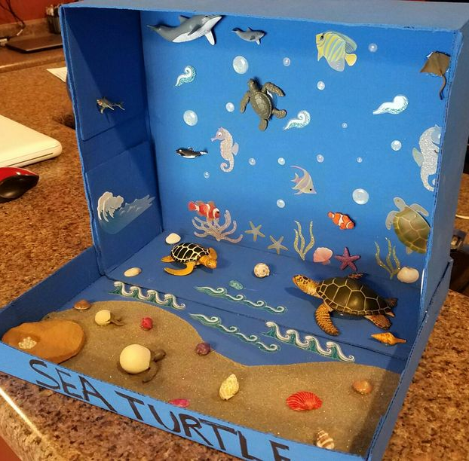
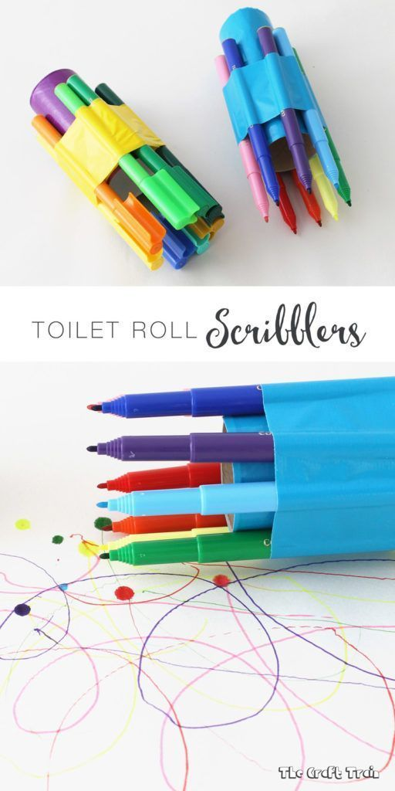
Un exemple d’un diorama d’une tortue.
Pratique à écrire tes mots d’ortho avec plusieurs couleurs en même temps.

Slide 4
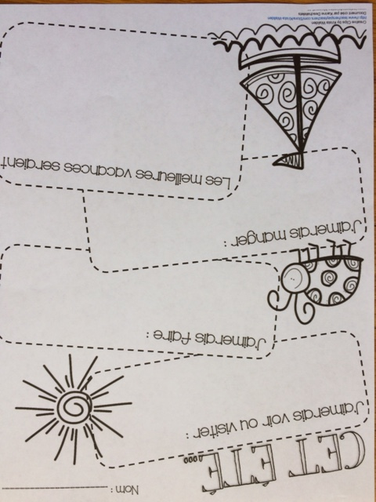

Slide 5
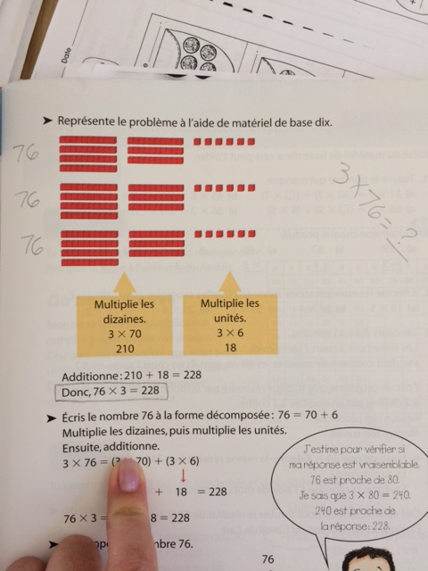
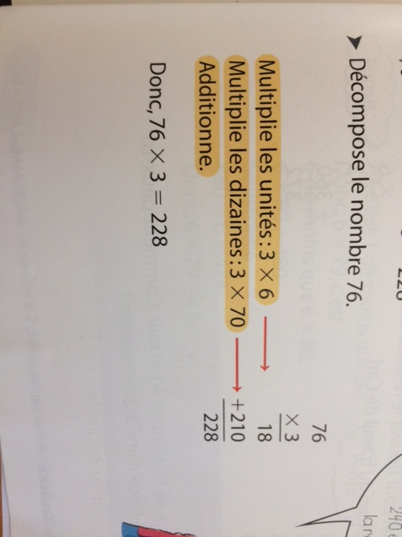
To find the answer, you can use the base ten blocks.
Or, the more old fashion way! You decide.

