Slide 1
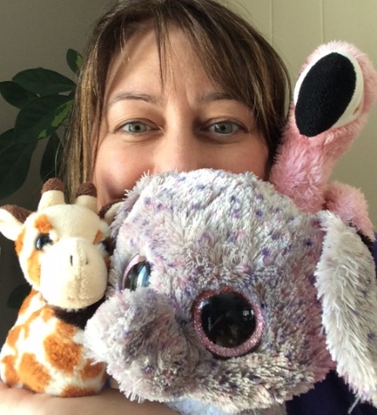
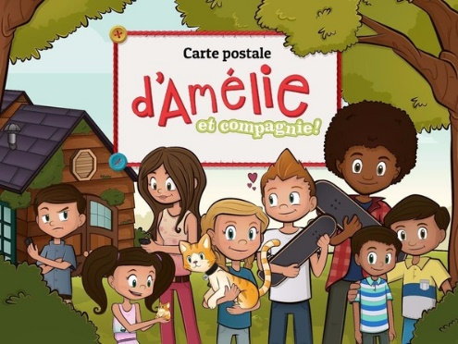
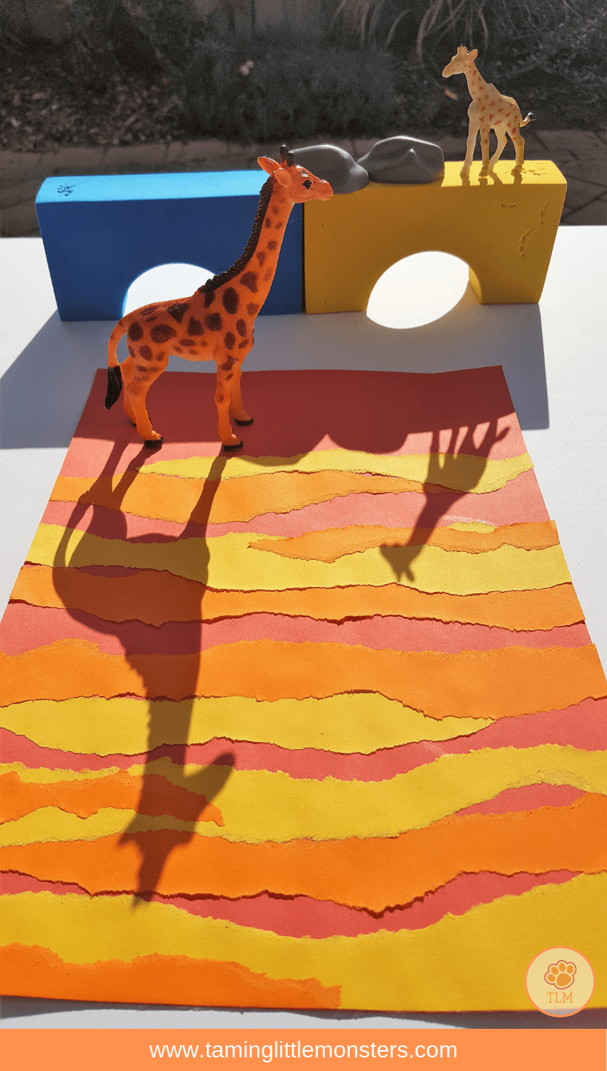
Terry Fox Elementary
Mme LeBreton’s Classroom Home learning (June 1-5)
Lecture
Mots de la
semaine
Keep reading one book per day with this Internet site: Il était une histoire.
iletaitunehistoire.com
Bonne lecture!
(#157-162)
- rapide -rouge
-regarde -samedi
-rose -seize
Tu peux aller les écrire dehors (chaulk, pebbles).
Art
Since we are talking about habitats in science, we are going to do a shadow of a wild animal! Do a background with the colors of the sun, forest or sky and trace your animal. Look at the example.
Amuse-toi!
Écriture
This week, I want you to write a postal card. I found a free App to do your own. The name is: Carte postale d’Amélie.
Bonne écriture!

Slide 2
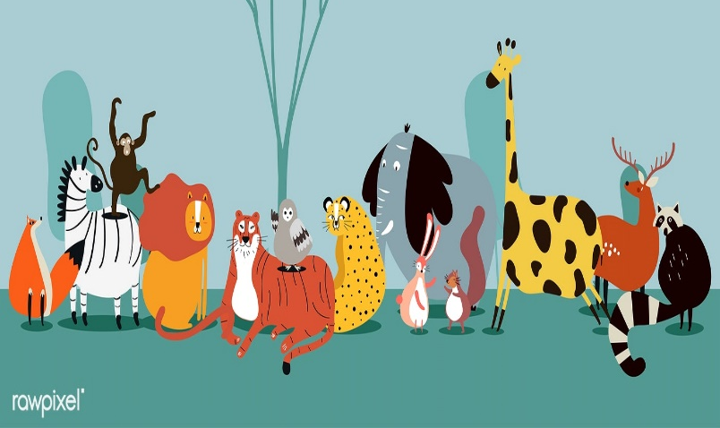
Science
We are now exploring the habitats. This week, I want you to learn more about the ecosystem and the food chain. Go on You Tube and listen to Bill Nye:
-Biodiversity
-Food Web
Bonne écoute!
More? Go on the Internet and check for: the best zoo live streams for kids.
Math
This week homework will still be about geometry. You will work on the reflection and symmetry. I’m leaving you an explanation on how to do it and some exercises for you to practice.
Also, I found a nice way to do more geometry. Go on: mathisfun.com and choose Geometry. In the middle of all the activities, you will find the symmetry section.
Pratique bien!
Écoute!
Don’t stop listening to a French tv show. And remember to talk or write about it.
Enjoy!
App.
amusant
et gratuit:
Science Max 2:
Experiments
at large
Bonne semaine!

Slide 3
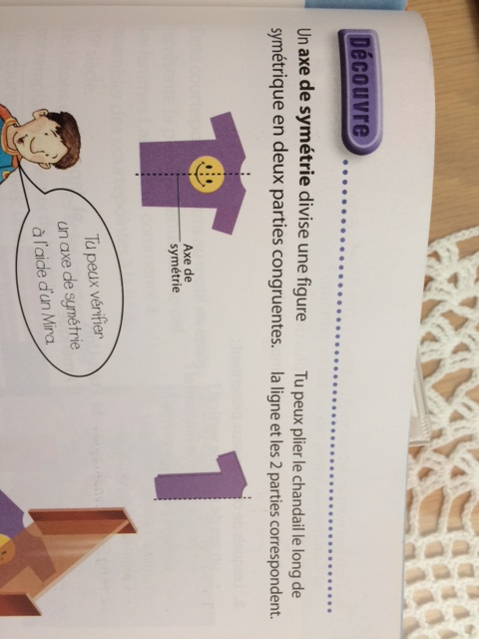
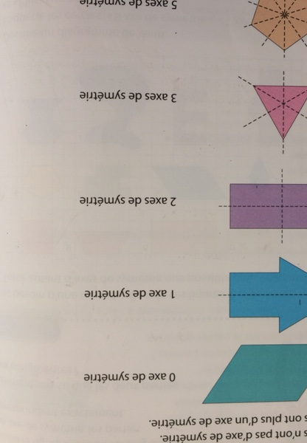
When you have a “axe de symétrie’’ it is when you can divide the shape in two and each side is the same if you would fold it on that line. Some shapes may have none, one or many.

Slide 4
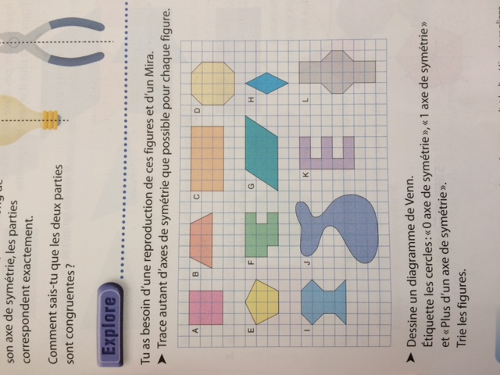
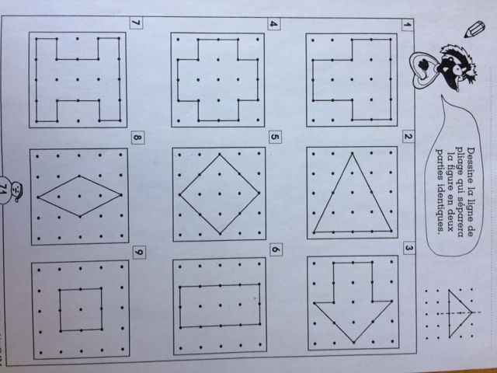
Trouve le/les axes de symétries.

Slide 5
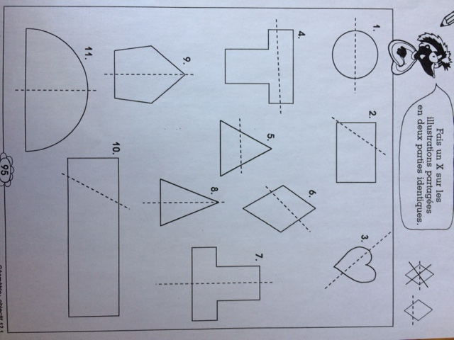
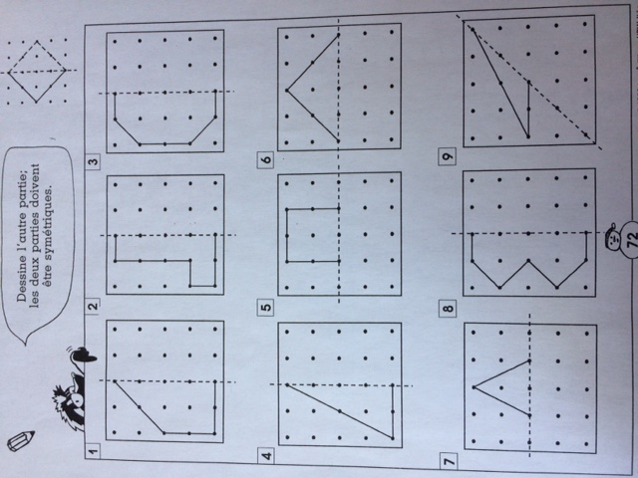
Bon ou pas bon?
Dessine l’autre moitié du dessin.

Slide 6
