Slide 1
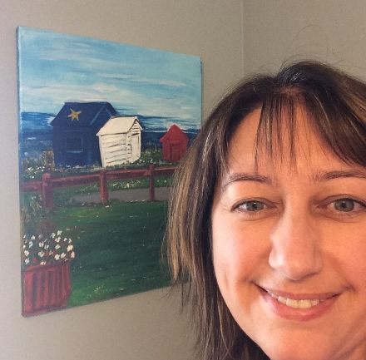


Terry Fox Elementary
Mme LeBreton’s Classroom Home learning (May 11-15)
Lecture
Mots de la
semaine
Keep reading one book per day with the NB public library. They have a section for age 0-12 with over 1000 books that you can download and read. The address is:
litterature-jeunesse-libre.fr
Click “la bibliothèque” on the left of the girl reading a red book.
(#139-144)
-partout -petit
-pas -petite
-personne -peu
Regarde l’exemple pour te pratiquer.
Art
This week it’s all about l’Acadie! Many of you are Acadians, just like me, so I took a photo of the cute sheds in Petit-Rocher. Do a drawing or a painting of them.
Amuse-toi!
Écriture
I want you to take a paper and write all the letters of the alphabet going down. Go around the house or outside, find and write something in French beginning with each letter.
Bonne écriture!

Slide 2

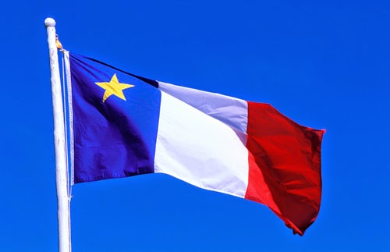
Sc. Humaine
We are still exploring our world. This week, I want you to know the provinces and territories of our beautiful country, Canada. Listen to the song: Canada Geography/Canada Country on You Tube. I’m leaving you some pictures to help you practice.
Vive le Canada!
Math
This week homework will be about money. We will start by practicing the addition. I’m leaving you an example on how to add the money and some exercises from our math book. When you are done adding, you can take a calculator to check your answers.
Also, I found a nice way to practice on the Internet. Go on: mathisfun.com after choose the option: money.
Pratique bien!
New for parents:
The ASD-N at Home Learning Page has been launched.
http://asd-n.nbed.nb.ca/
App.
amusant
et gratuit:
French in pictures Lite
Bonne semaine!

Slide 3
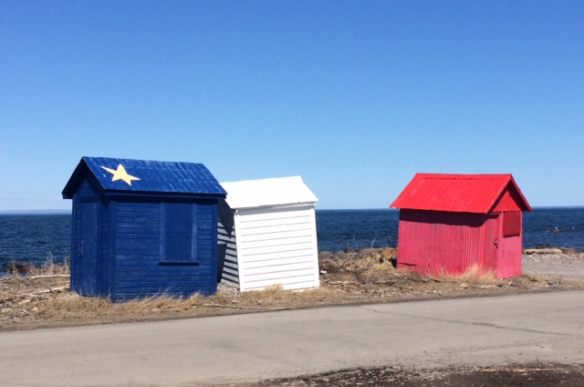

Slide 4
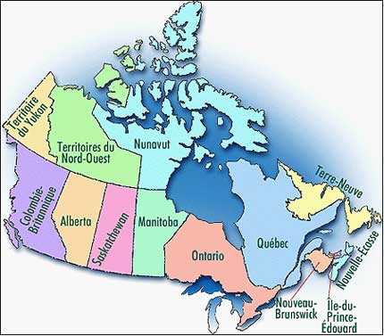
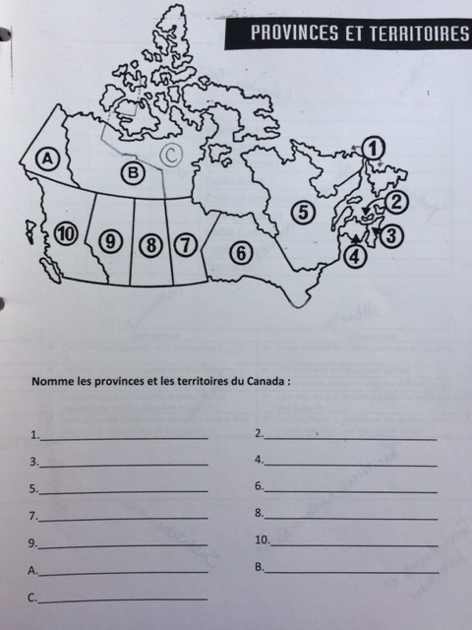

Slide 5
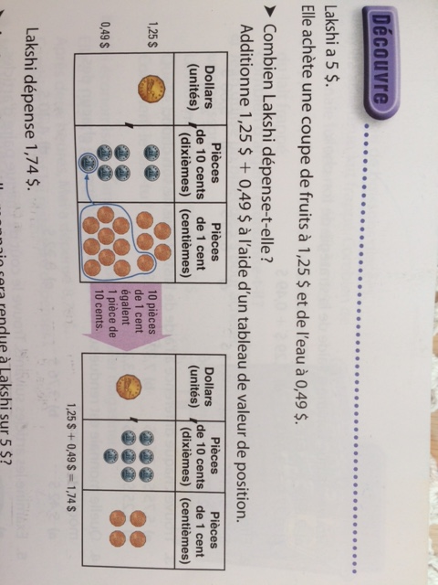
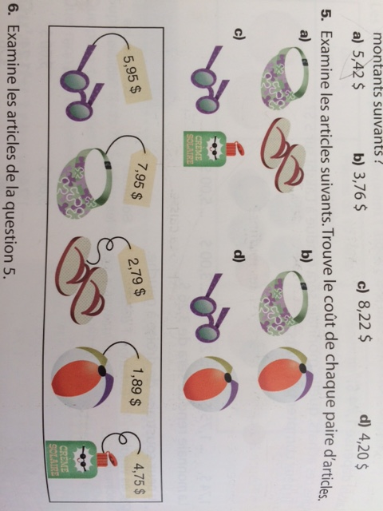
HOW? This is one way that you can add money. Instead of drawing the ten blocks, you draw the coins.
Add the two things together.

Slide 6
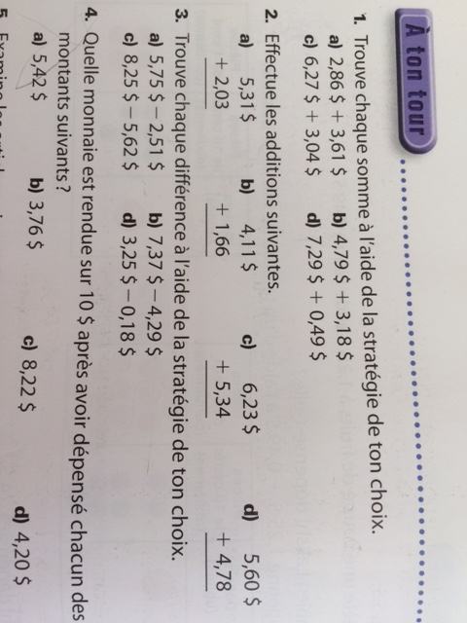
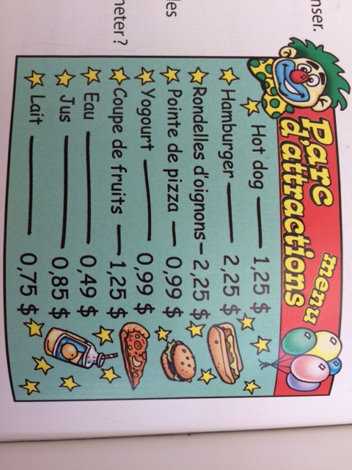
What would you like to order? Do the addition.

