Slide 1
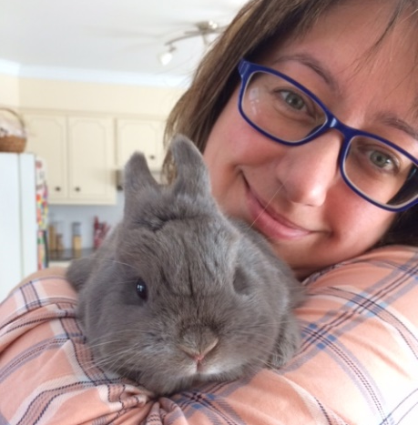
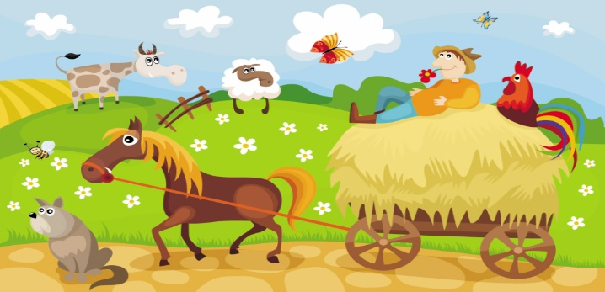
Terry Fox Elementary
Mme LeBreton’s Classroom Home learning (May 18-22)
Lecture
Mots de la
semaine
Keep reading one book per day with the NB public library. They have a section for age 0-12 with over 1000 books that you can download and read. The address is:
litterature-jeunesse-libre.fr
Click “la bibliothèque” on the left of the girl reading a red book.
(#145-150)
- plus -préféré
-pour -puis
-pourquoi -quand
Regarde l’exemple pour te pratiquer.
Art
May 22nd is Mini-Vegas birthday! Wow, one year old. We all love cute animals, especially ours. So, why not an easy painting of your favorite domestic animal. Look at the example.
Amuse-toi!
Écriture
I want you to write a letter to someone. Remember to have an introduction, middle and conclusion. Mail it, email it or leave it on the doorstep of the lucky person.
Bonne écriture!

Slide 2
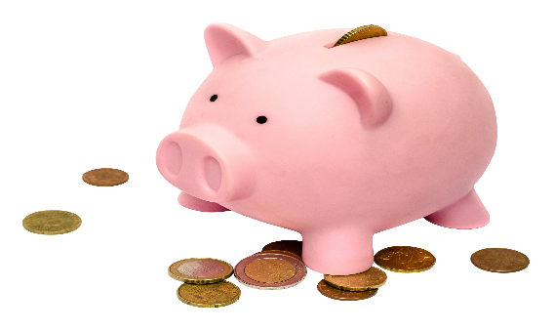
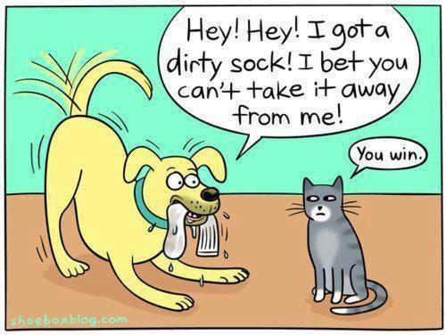
Sc. Humaine
We are still exploring our world. This week, I want you to learn about deserts and climates. Go on You Tube and watch Bill Nye. He has one episode for each.
Vive la terre!
You want to do more science? Go check:
http://stemnorth.nbed.nb.ca for weekly steam activities.
Math
This week homework will be about more money. We will continue by practicing the subtraction. I’m leaving you an example on how to do it and some exercises from our math book. When you are done, you can take a calculator to check your answers.
Also, I found a nice way to practice on the Internet. Go on: mathisfun.com after choose the option: money.
Pratique bien!
Écoute!
Don’t stop listening to a French tv show. And remember to talk or write about it.
Enjoy!
App.
amusant
et gratuit:
Learn French
For beginners
Bonne semaine!

Slide 3
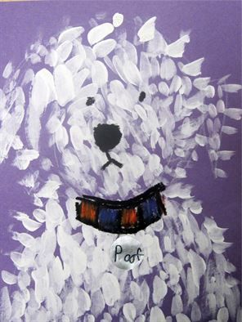
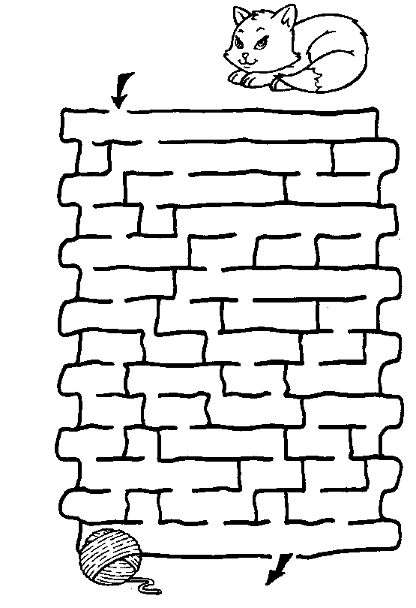
Art:
Use one finger for the paint.
Instead of doing a line, write your 6 words to find the way!

Slide 4
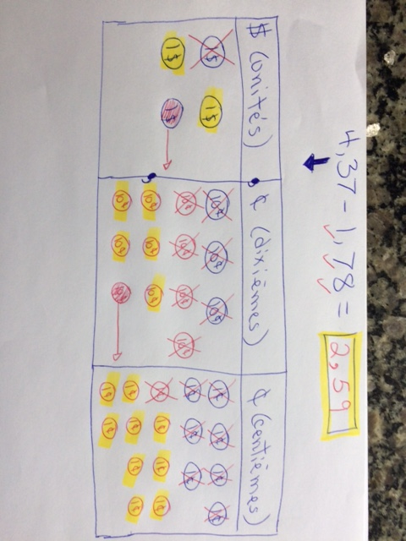
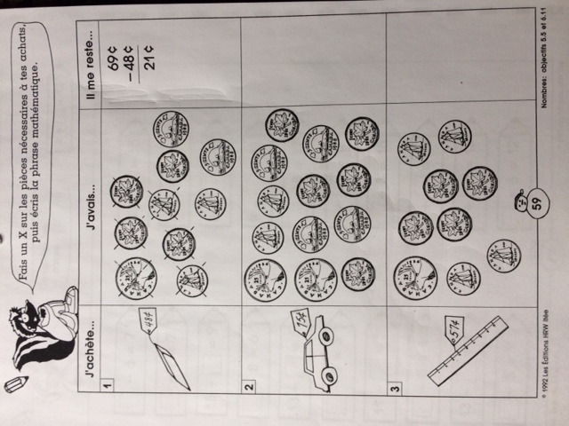
HOW? This is one way that you can subtract money. Instead of drawing the ten blocks, you draw the coins.

Slide 5
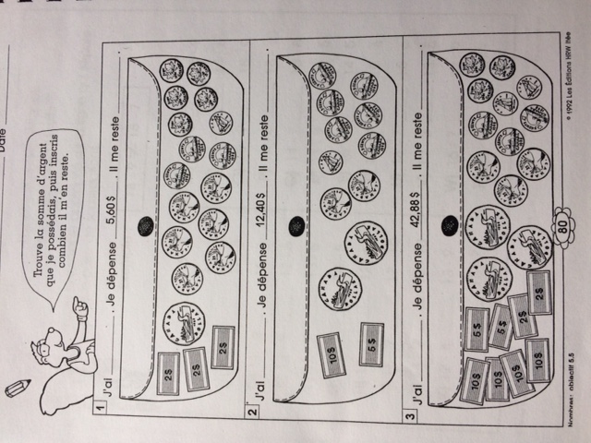
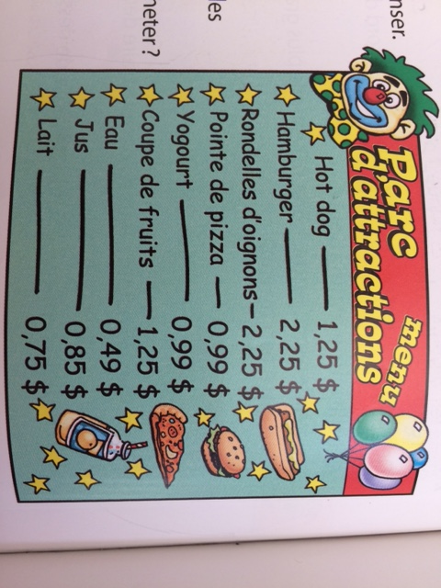
What would you like to order? You have 10$ or 5$ minus what you want. How much money do you have left?

Slide 6
