Slide 1
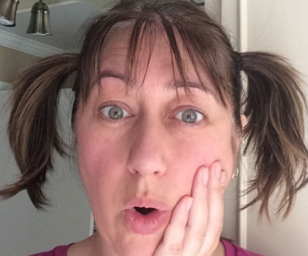

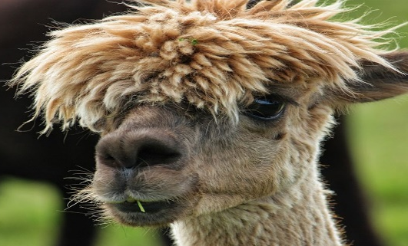
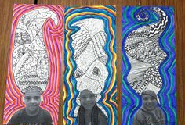
Terry Fox Elementary
Mme LeBreton’s Classroom Home learning (May 25-29)
Lecture
Mots de la
semaine
Keep reading one book per day with these previous Internet site:
-Abracadabra: literacy.concordia.ca
- The NB public library:
litterature-jeunesse-libre.fr
- Ebookids.com
(#151-156)
-quatorze -qui
-que -quinze
-qu’est-ce -quoi
Choisis comment les pratiquer cette semaine.
Art
Oh yah! It’s bad hair day every day right now. So, take a picture of your face, cut it out, glue on paper and draw some funky hair on yourself. Look at the example.
Amuse-toi!
Écriture
I want you to write a funny comic strip. I’m leaving you the beginning of one. You need to continue the way you want.
Bonne écriture!

Slide 2
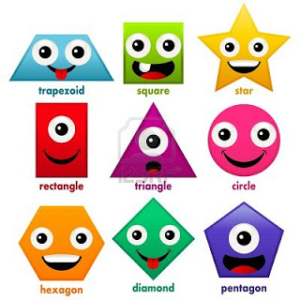
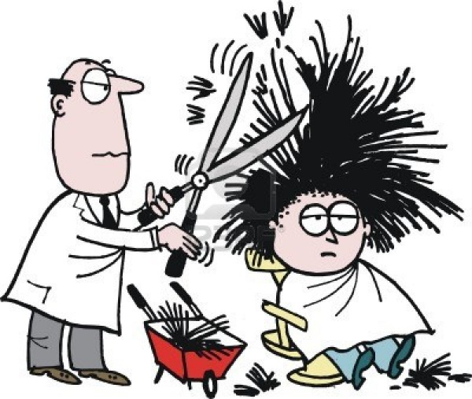
Sc. Humaine
We are still exploring our world. This week, I want you to use the information from last week (deserts and climates) and fill in the sheet about the 3 climate zones. You can draw or write the answer. What kind of house, clothe and outside activity for each zone.
Vive les climats différents!
Math
This week homework will be about geometry. You will work on the development (when you open a shape, what does it look like) and counting the different parts of a shape. I’m leaving you an explanation on how to do it and some exercises for you to practice.
Also, I found a nice way to have fun with shapes with two free Apps: 1) Geoboard, by The Math Learning 2) Tangram Geometry.
Pratique bien!
Écoute!
Don’t stop listening to a French tv show. And remember to talk or write about it. You can check: Oniva! Radio-Canada.ca
Enjoy!
App.
amusant
et gratuit:
TVOKids
Math Castle
Bonne semaine!

Slide 3
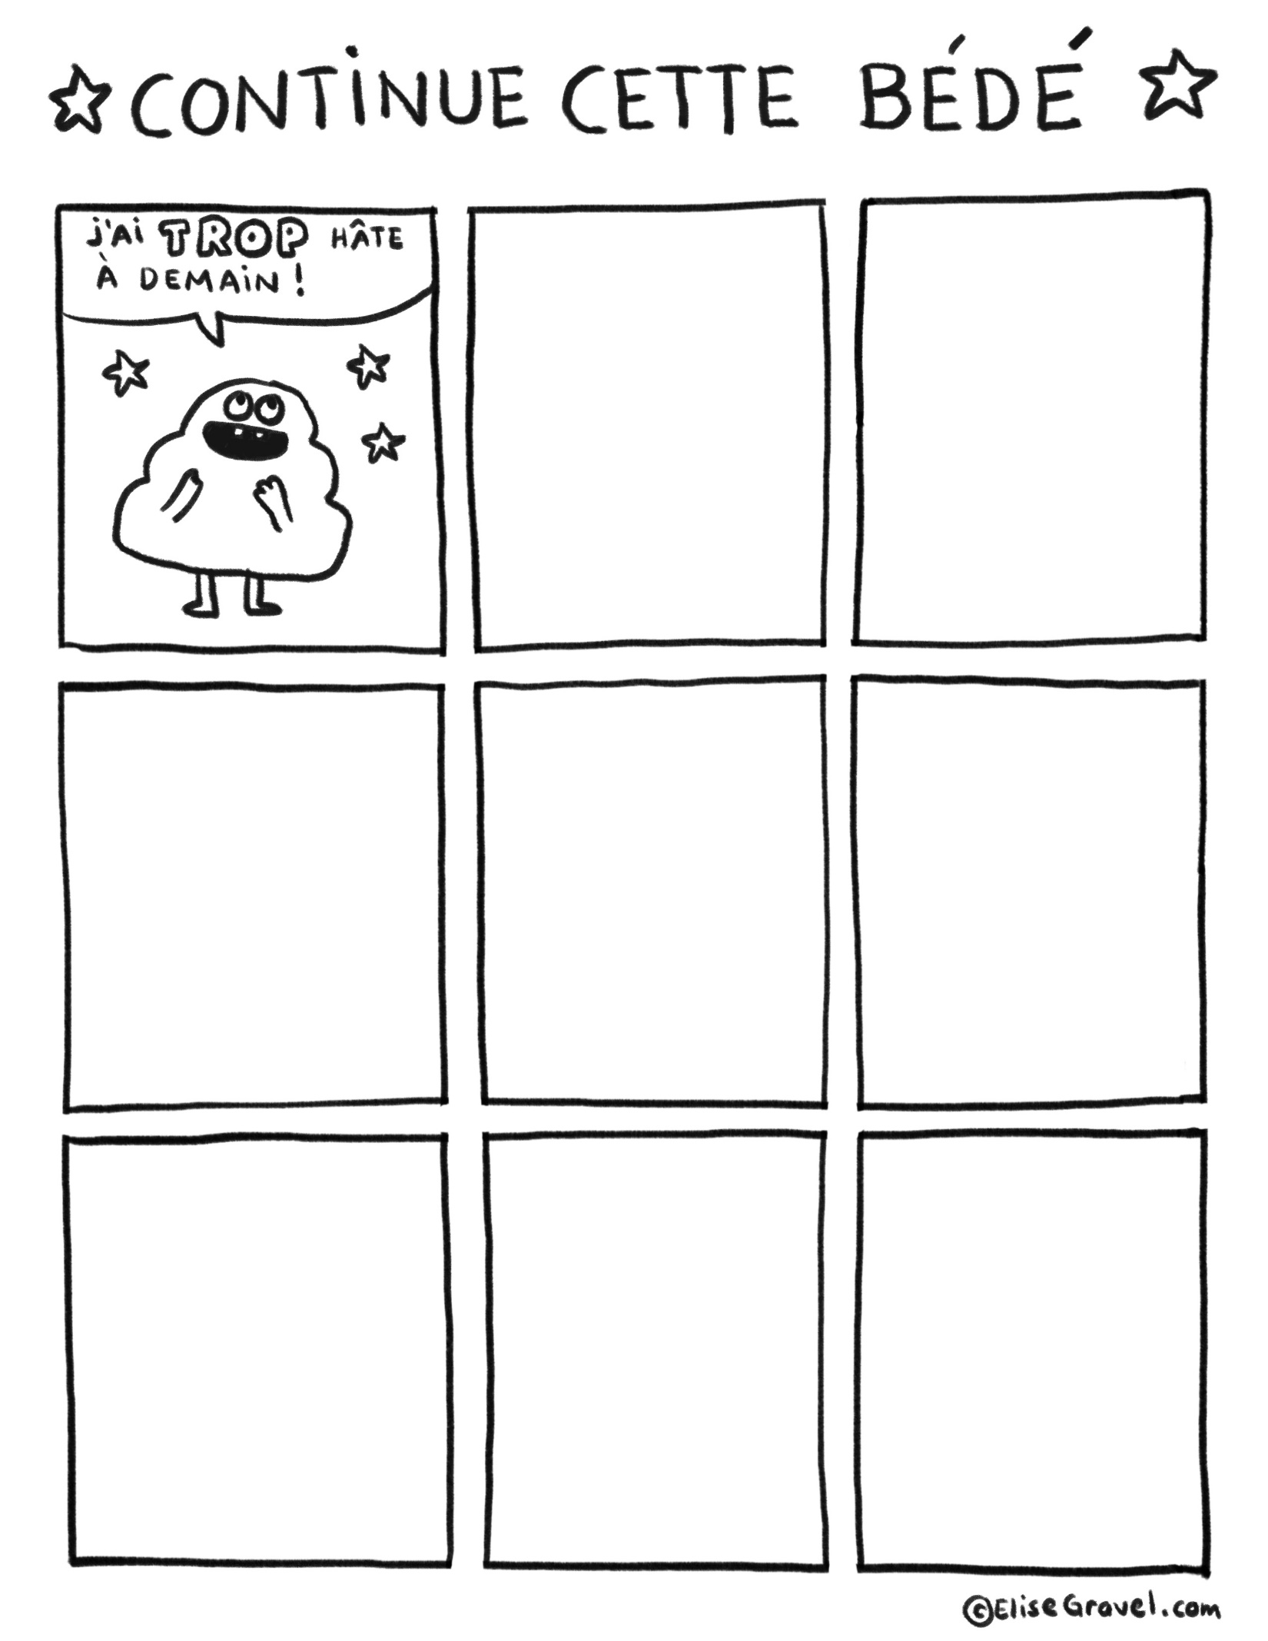

Slide 4
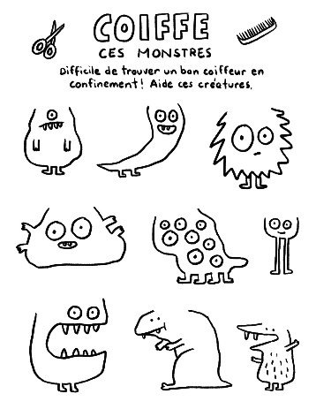
Très chaud!
Quatre saisons!
Très froid!

Slide 5
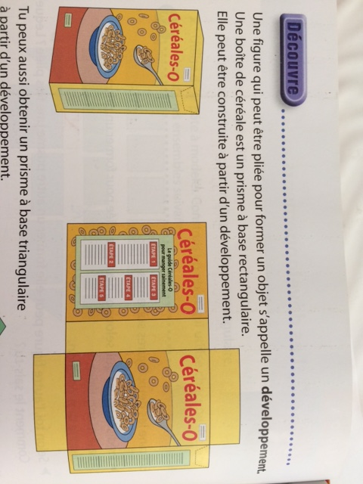
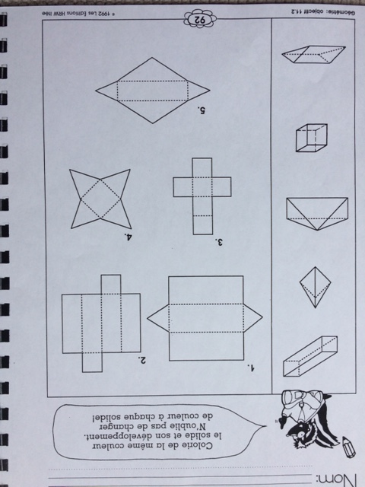
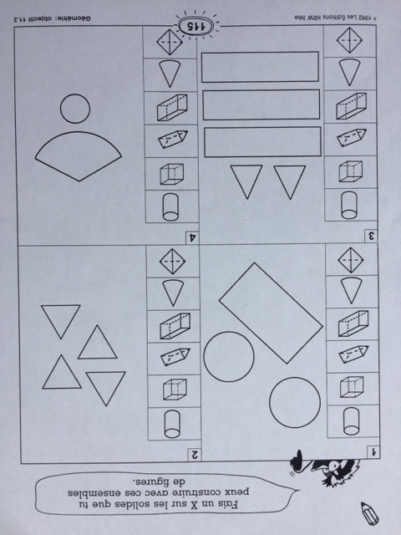

Slide 6
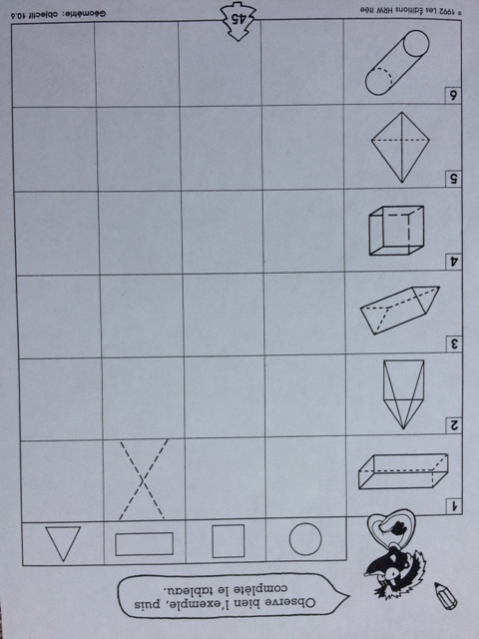
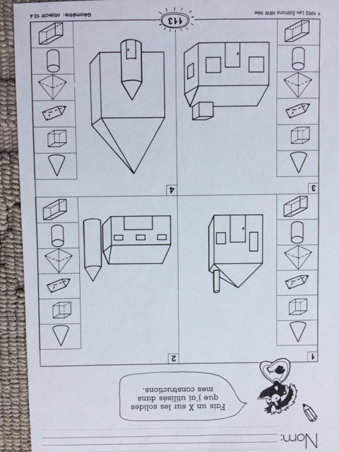

Slide 7
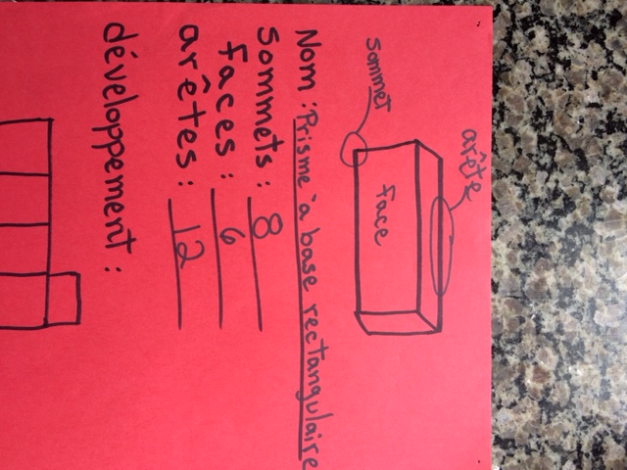
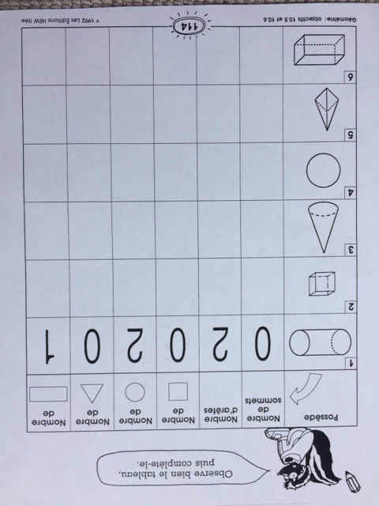
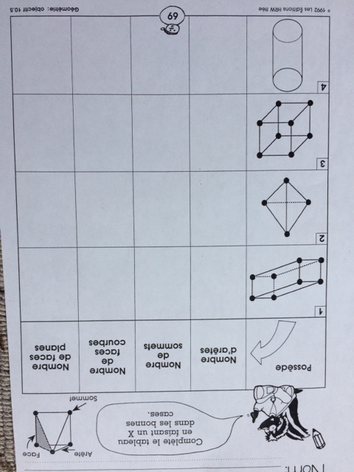
0
0
0
0

