Slide 1
Terry Fox Elementary
Mme LeBreton’s Classroom Home learning (May 4-8)
Lecture
Mots de la
semaine
Keep reading one book per day with the site:
Ebookids.com
And choose French.
(#133-138)
-où (where) -par
-oui -parce que
-papa -parfois
I’m leaving you an example to practice them.
Écriture
I want you to take some paper and make a small book and write a story, just like during Le 5. I’m leaving you a mix-up story. Put the 4 pictures in order and invent a French story.
When you are done, read it or give it to someone.
Bonne écriture!
Art
Sunday, May 10th is Mother’s Day! You have to do something special for her. Again, DLTK from the Internet as a section and I’m leaving you a photo of a pretty card.
Make sure to hide yourself when making it, shhhh!
Amuse-toi!

Slide 2
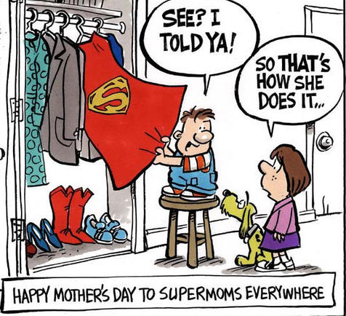
Sc. Humaine
We are still exploring our world. This week, I want you to know what is the cardinal directions. Go on You Tube and watch: Cardinal Directions on Brainpop Jr.
After, you can do the puzzle of Canada. Give yourself extra minutes, it’s harder than you think!
Patience!
Math
This week homework will be more fractions. This week, you are going to order the fractions. Go check 2 nice videos on You Tube that explains it (1: comparing & ordering fractions for beginners, 2: comparing and ordering fractions with different denominators). I’m leaving you some pictures.
You want to do more, after my activities? I’m sure you can find some interesting games on the Internet if you do a search (ex. comparing, ordering fractions free games for kids).
Pratique bien!
Écoute!
Don’t stop listening to a French tv show. And remember to talk or write about it.
Enjoy!
App.
amusant
et gratuit:
Bonhomme
Pendu
Bonne semaine!

Slide 3
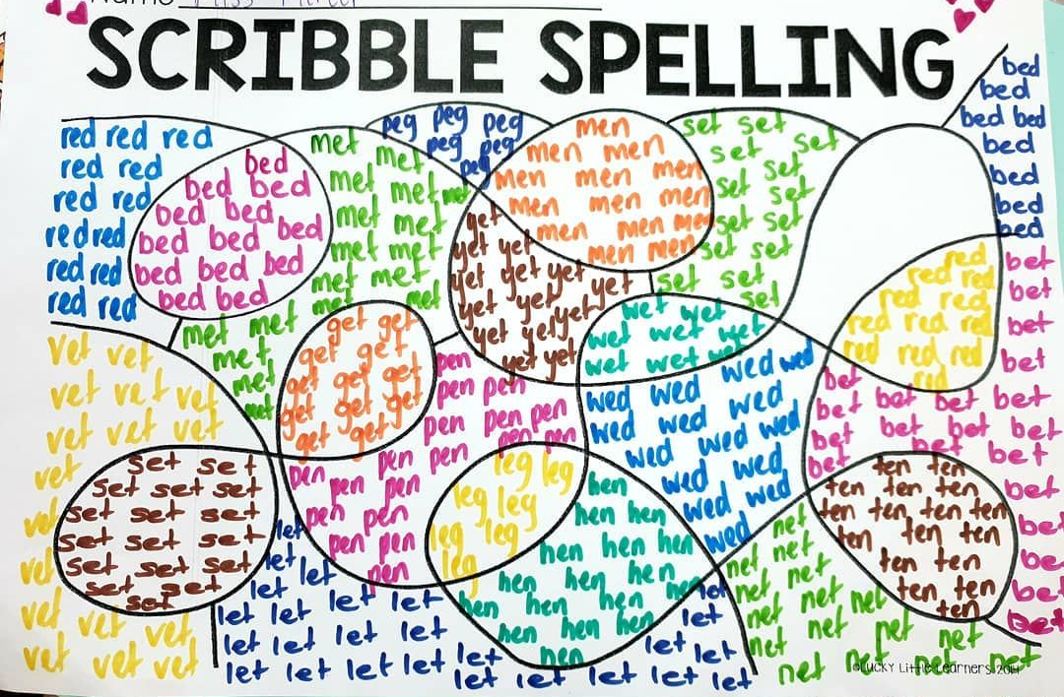
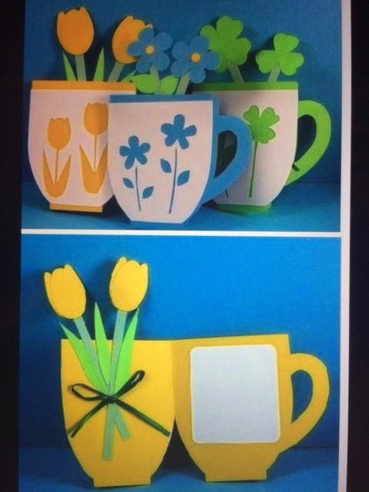

Slide 4
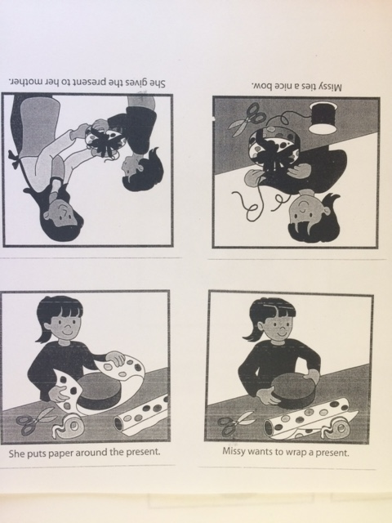
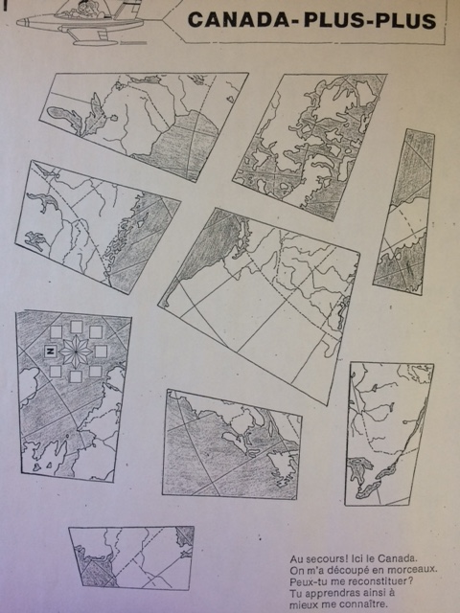

Slide 5
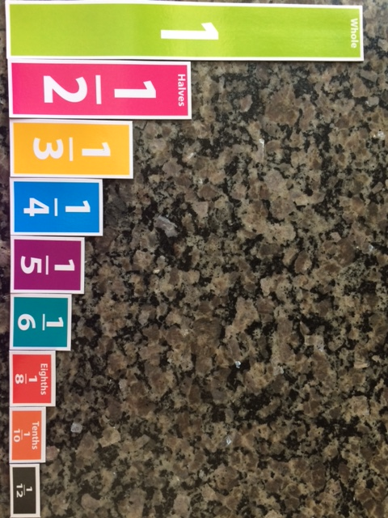
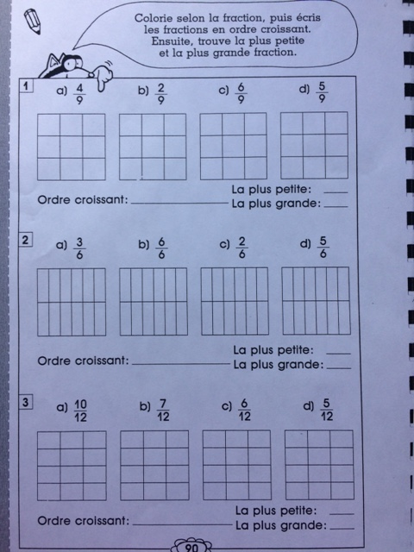

Slide 6
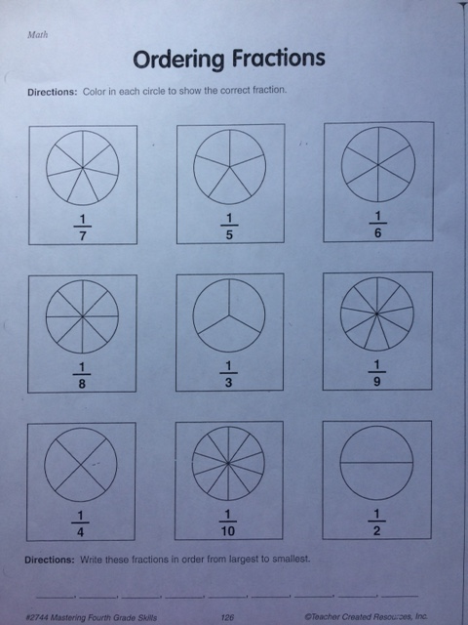
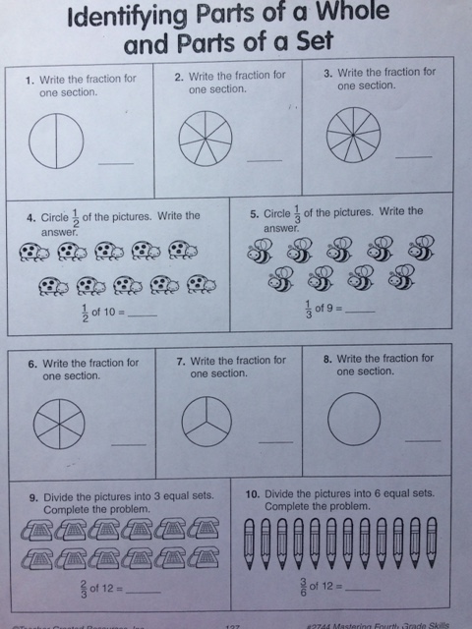

Slide 7
