Slide 2
Health Info Public Health May 2017

Slide 3
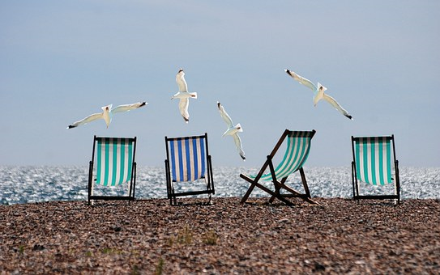
Summer and vacation are almost here!
Notes:
3

Slide 4
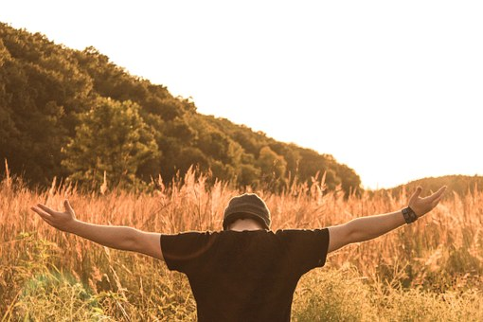
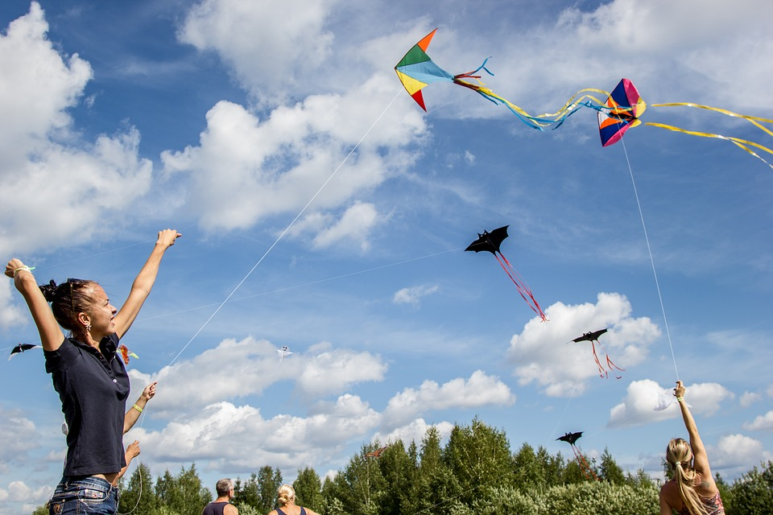
Will you enjoy summer?
Notes:
4

Slide 5
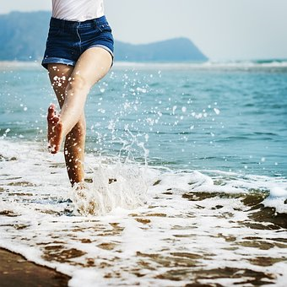
Going outdoors allows you to:
● Breath fresh air
● Improve your health
● Sleep better
● Feel good
● Have more energy

Slide 6
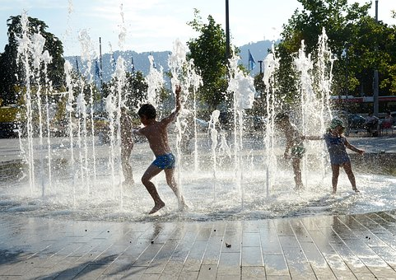
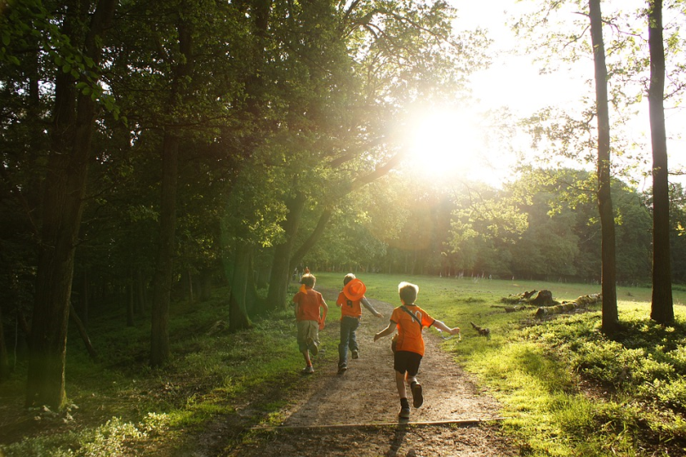
Unstructured activities can have many benefits
Put more energy into having fun rather than competing.
Notes:
6
6

Slide 7
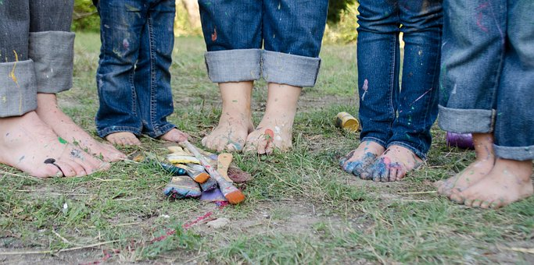
Celebrate summer outside!
Take the opportunity to do activities with your family outside.

Slide 8
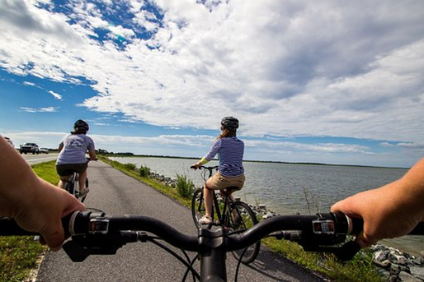
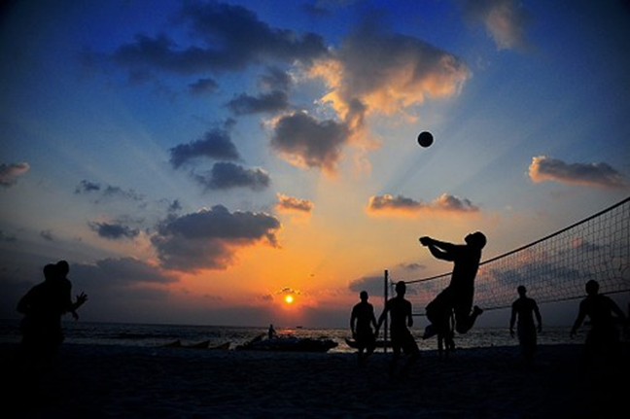
Have fun! Enjoy summer!
Invite your friends to play outside!

Slide 9
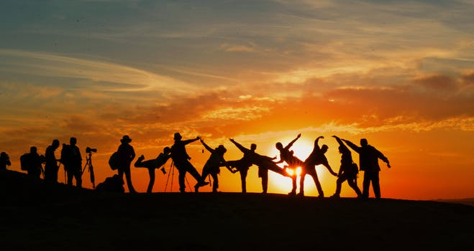
Go outside! Have fun and stay healthy!
Notes:
9

