Slide 2
Health Info Public Health January 2017

Slide 3
Yoga!

Slide 4
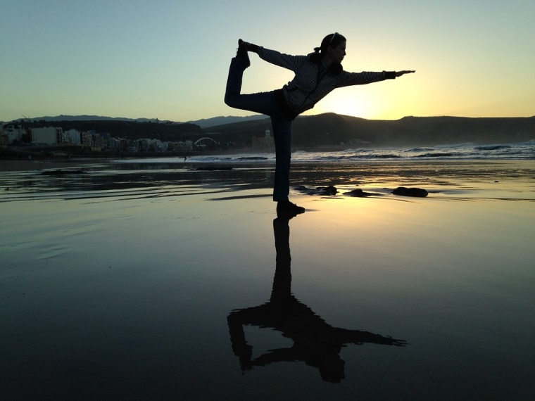
What is yoga?
Yoga is a series of exercises that are good for your body, breathing and brain.
Form of meditation!
Stretching!
Mind-body approach!

Slide 5
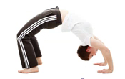
Benefits of Yoga!
Yoga can help you to be more:
Calm and relaxed!
Creative and concentrated!
Aware of your body!
Confident!

Slide 6
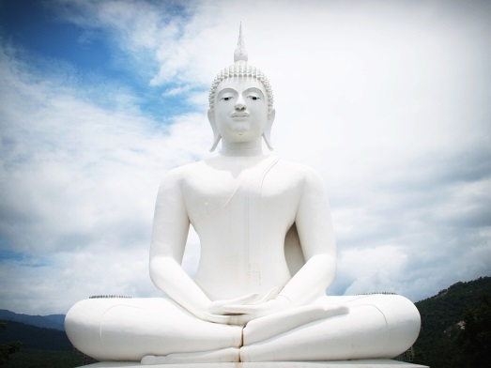
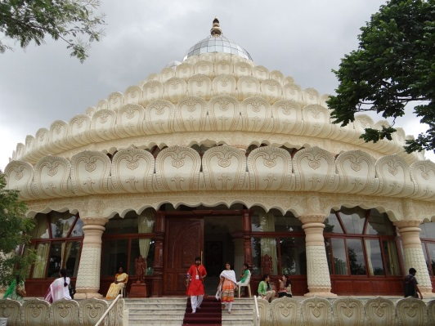
Some Interesting Facts
Yoga started in India over 3,000 years ago.
Yoga includes:
Physical poses (asanas)
Breathing techniques (pranayamas)
Meditation
Deep relaxation (yoga nidra)

Slide 7
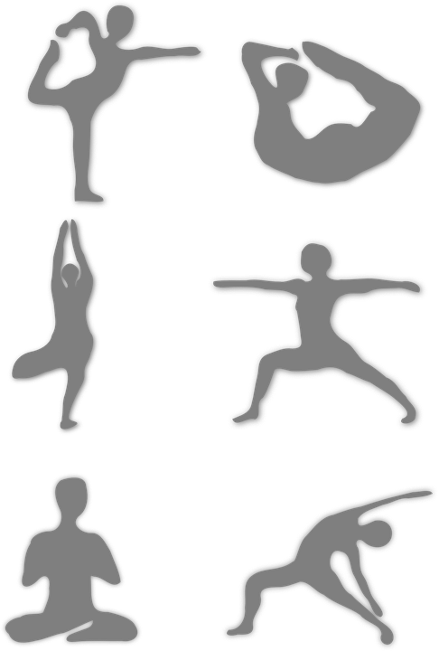
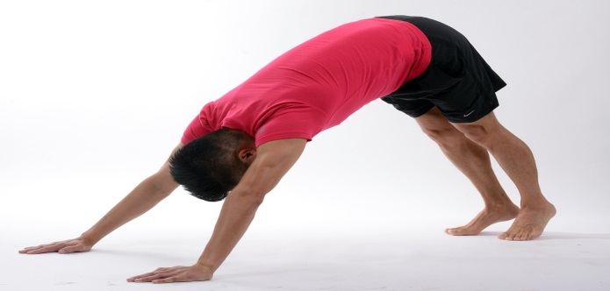
Some Yoga Poses
The cat!
The downward dog!

Slide 8
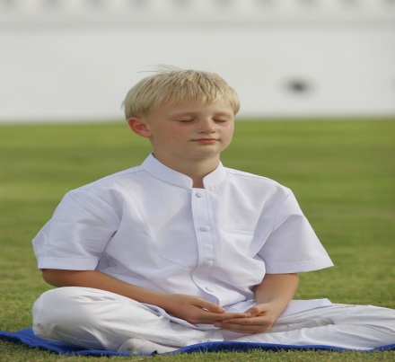
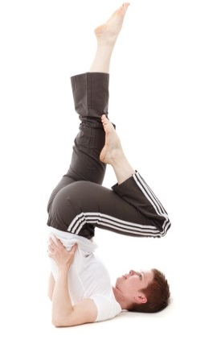
When you do yoga:
Don’t think about anything, just relax!
Listen to soft music!
Inhale through your nose!
Exhale through your nose or your mouth!

Slide 9
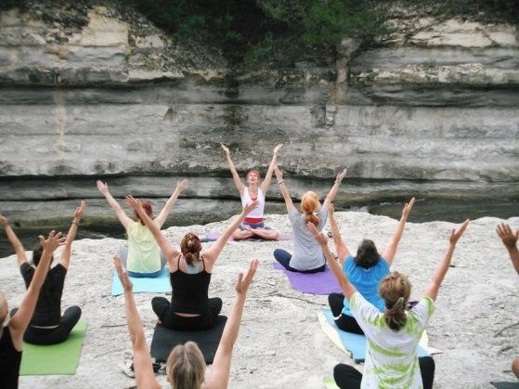
Yoga is fun!
You can do it:
Alone or in a group!
At a yoga studio, at home, on the beach or even outdoors!
Yoga should not hurt, when it is done correctly.

Slide 10
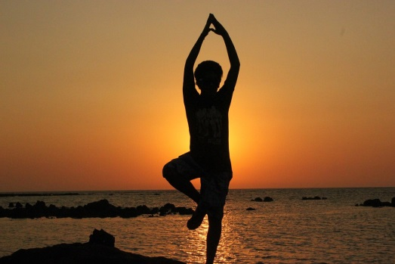
Take the time to practise yoga and breathe! Have fun!
In closing

