Slide 2
Health Info
Public Health
May 2015
Notes:
2

Slide 3
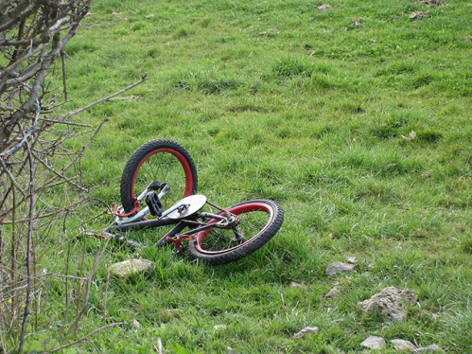
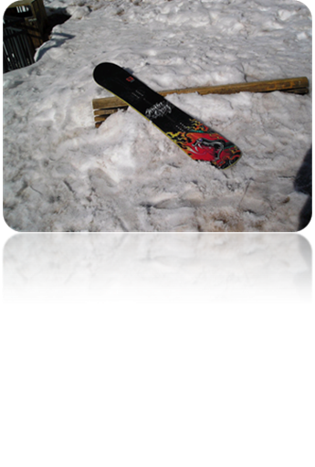
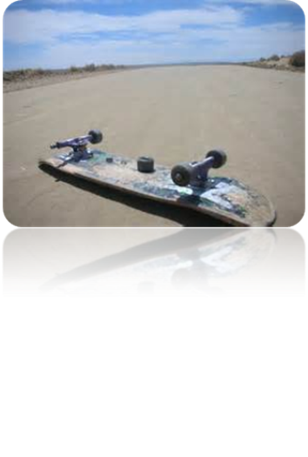
Wearing helmets
Nearly 88% of serious head injuries could be prevented by wearing helmets.

Slide 4
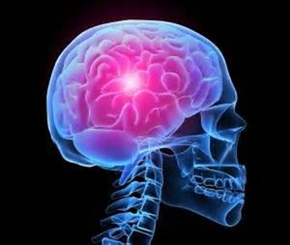
Did you know that…
The skull is approximately one centimetre thick.
A collision at a speed of 7 to 10 km/hr. can cause a skull fracture.

Slide 5
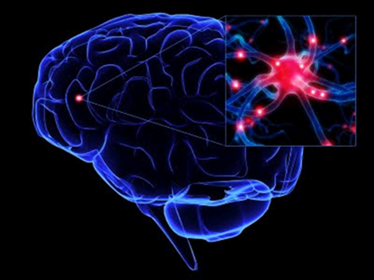
Concussions
Most concussions (head trauma) can be prevented.
Wear a helmet when snowboarding, skateboarding, inline skating, and doing many other activities such as hockey, football, skiing, and skating.

Slide 6
Wear a helmet
A good fitting helmet protects your head.
Choose a helmet appropriate for the activities you do.

Slide 7
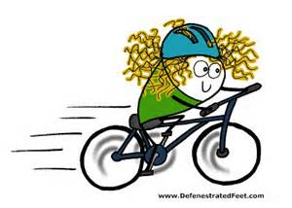
Wear a helmet
Helmets must be certified by the CSA,CPSC or Snell.
In New Brunswick, helmets are compulsory for ALL cyclists.

Slide 8
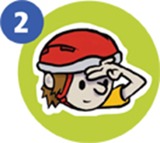
Choosing a bike helmet
Follow the 2 V 1 rule:
2 fingers above the eyebrows
The strap forms a V under the ears.
1 finger between the strap and the chin

Slide 9
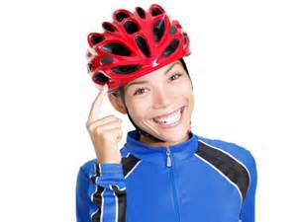
Protect your head!
Head injuries can happen at any age. Wear a helmet.
Children and teens are more likely to wear a helmet if they see adults doing so.

