Slide 2
Health Info
Public Health
March 2015

Slide 3
Eating Well from 9 to 5!
Solutions to
School days challenges

Slide 4
Eating well on school days gives you:
Better concentration in class
Vitality and good health
Energy to work and move
Essential nutrients

Slide 5
What are you eating for lunch?
To stay healthy, choose foods from each of the four groups of Canada’s Food Guide!
For your lunch eat different colors of vegetables:
  - Soup or salad
  - Raw or cooked vegetables
Savour whole grains:
  - Whole grain breads
  - Brown rice or whole wheat pastas

Slide 6
What are you eating for lunch?
To stay healthy, choose foods from each of the four groups of Canada’s Food Guide!
Include a serving of meat and alternative:
-Fish, chicken, beef or pork
-Legumes (ex.Beans), eggs or peanut butter
Drink a cold glass of milk or water

Slide 7
What are you eating for lunch?
To stay healthy, choose foods from each of the four food groups of Canada’s Food Guide!
For dessert:
- Crunch into a piece of fresh fruit
  - Eat yogurt
  - Eat a healthy dessert made from fruit
  and/or whole grains

Slide 8
Not enough time for lunch?
Get it done in a snap!
Peanut butter and banana sandwich with milk
Scrambled eggs, bread, carrot sticks and yogurt
Canned legumes, bread, apple and milk
Canned tuna or salmon sandwich with an orange and milk
Notes:
Beans or legumes ???

Slide 9
Visit www.nutritionmonth.ca
For ideas on healthy foods ‘ to go’
For advice on healthy eating
For tips on how to eat well, even when you are in a hurry

Slide 10
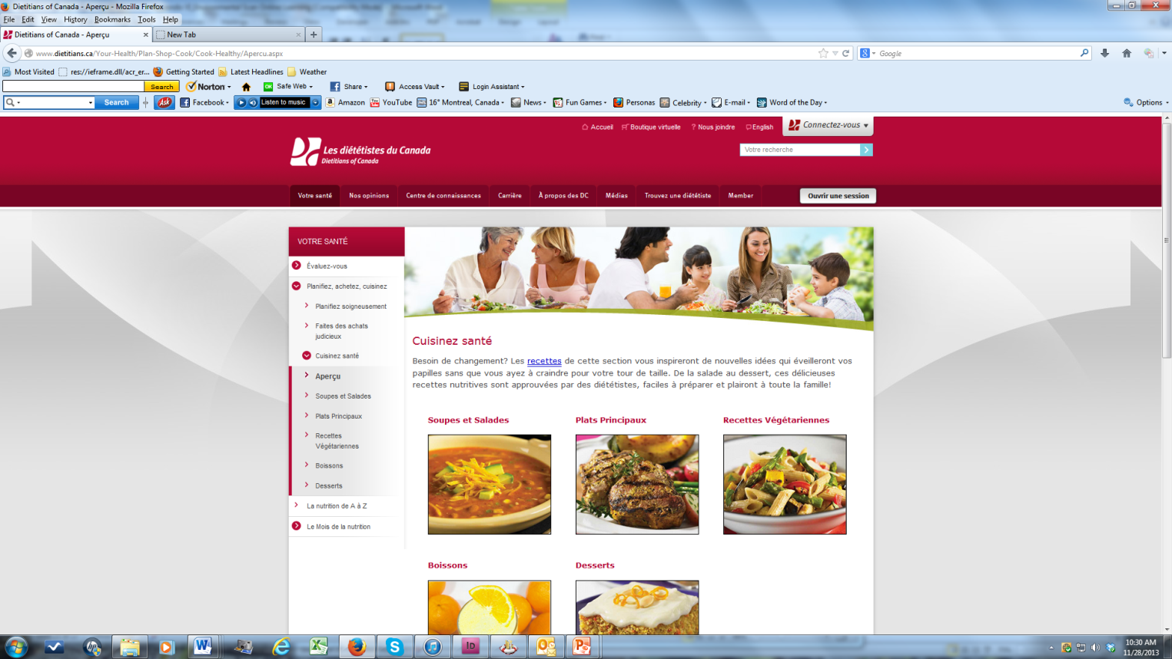
Visit www.dietetians.ca
Find recipes, cooking ideas and advice on healthy eating.
See dietitian’s video.
Find a dietitian in your area.

Slide 11

Download applications!
Eatipster at www.eatipster.com
Cookspiration at www.cookspiration.com
EATracker at www.eatracker.com

